Slide 1
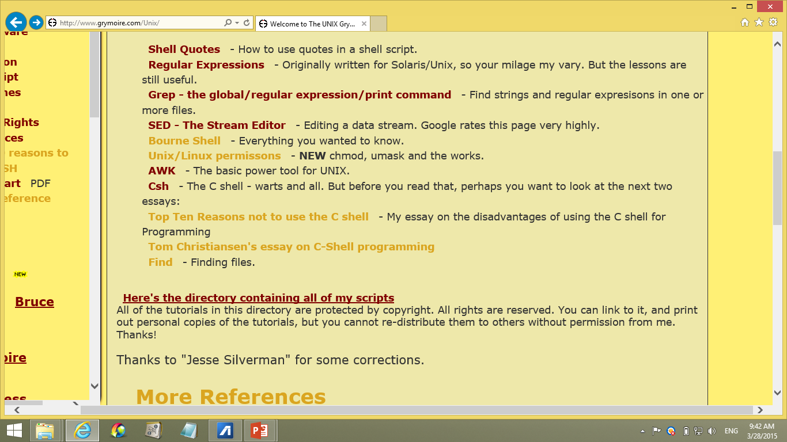

Now we're
done with
these five!
That leaves this one

Slide 2
awk
Awk is programming language for text and data manipulation tasks with only a few lines of code.
It has some overlapping capabilities with sed, but:
Instead of sed's single letter commands, Awk commands look like C.
Instead of machine-language-like control flow, Awk uses C-like control flow (ie: for, while).
Instead of only text, Awk understands numbers.
Instead of a hold space, Awk allows variables.
So: much more powerful, but more keystrokes.

Slide 3
awk
Awk syntax looks a little like C but:
It has built-in string and number data types
It has no variable declarations
It uses associative arrays
It automatically handles
Reading input lines
Splitting input fields
Converting string and number data types
Initializing variables
Managing memory
So, syntax similarities to C aside, it is actual more like Python, and especially like Perl.

Slide 4
Development timeline
grep
So, one reason to learn
awk is if you hope
to later learn perl.
(but no perl in this class.)
egrep
sed
awk
These awk extensions
have some extra
features, including
user functions.
nawk
perl
gawk
PHP
Python
Or learn PHP
Or learn Python

Slide 5
Running an AWK Program
Like grep, awk can take input:
From a file named as an argument:
% grep 'pattern' file
% awk 'program' file
From standard input:
% grep 'pattern' < file
% awk 'program' < file
From the pipe:
% cat file | grep 'pattern'
% cat file | awk 'program'

Slide 6
Running an AWK Program
Like sed, awk can load its program:
From the command line:
% sed 'program' < file
% awk 'program' < file
From a program name on the command line:
% sed -f program_filename < file
% awk -f program_filename < file
From an executable awk file:
% ./sedscript < file
% ./awkscript < file
% head -1 awkscript
#!/usr/bin/awk -f

Slide 7
The Structure of an AWK Program
Awk programs consist of:
An optional BEGIN segment
For processing to execute prior to reading input
pattern - action pairs
Processing for input data
For each pattern matched, the corresponding action is taken
An optional END segment
Processing after end of input data
BEGIN{action}
pattern {action}
pattern {action}
.
.
.
pattern { action}
END {action}

Slide 8
The Structure of Pattern-Action Pairs
You can skip the pattern or the action, but not both
AWK knows which, because actions are enclosed in { }
The default pattern is to match all lines
The default action is to print the line (or record)
So, then, what will each of these do?
cat f | '1{print}' ← prints all lines
cat f | ‘{print}' ← prints all lines
cat f | '1' ← prints all lines
cat f | '1;1;1' ← print each line three times
cat f | 'print' ← syntax error
cat f | '{x++}x%2' ← prints odd lines
cat f | ‘++x%2' ← prints odd lines

Slide 9
The Structure of Pattern-Action Pairs
You can skip the pattern or the action, but not both
AWK knows which, because actions are enclosed in { }
The default pattern is to match all lines
The default action is to print the line (or record)
So, then, what will each of these do?
cat f | awk '1{print}' ? prints all lines
cat f | awk ‘{print}' ← prints all lines
cat f | awk '1' ← prints all lines
cat f | awk '1;1;1' ← print each line three times
cat f | awk 'print' ← syntax error
cat f | awk '{x++}x%2' ← prints odd lines
cat f | awk ‘++x%2' ← prints odd lines
C-style conditionals are legal for patterns. What does “1” mean as a C conditional?

Slide 10
The Structure of Pattern-Action Pairs
You can skip the pattern or the action, but not both
AWK knows which, because actions are enclosed in { }
The default pattern is to match all lines
The default action is to print the line (or record)
So, then, what will each of these do?
cat f | awk '1{print}' ← prints all lines
cat f | awk '{print}' ? ← prints all lines
cat f | awk '1' ← prints all lines
cat f | awk '1;1;1' ← print each line three times
cat f | awk 'print' ← syntax error
cat f | awk '{x++}x%2' ← prints odd lines
cat f | awk ‘++x%2' ← prints odd lines

Slide 11
The Structure of Pattern-Action Pairs
You can skip the pattern or the action, but not both
AWK knows which, because actions are enclosed in { }
The default pattern is to match all lines
The default action is to print the line (or record)
So, then, what will each of these do?
cat f | awk '1{print}' ← prints all lines
cat f | awk '{print}' ← prints all lines
cat f | awk '1' ?← prints all lines
cat f | awk '1;1;1' ← print each line three times
cat f | awk 'print' ← syntax error
cat f | awk '{x++}x%2' ← prints odd lines
cat f | awk ‘++x%2' ← prints odd lines

Slide 12
The Structure of Pattern-Action Pairs
You can skip the pattern or the action, but not both
AWK knows which, because actions are enclosed in { }
The default pattern is to match all lines
The default action is to print the line (or record)
So, then, what will each of these do?
cat f | awk '1{print}' ← prints all lines
cat f | awk '{print}' ← prints all lines
cat f | awk '1' ← prints all lines
cat f | awk '1;1;1' ?← print each line three times
cat f | awk 'print' ← syntax error
cat f | awk '{x++}x%2' ← prints odd lines
cat f | awk ‘++x%2' ← prints odd lines

Slide 13
The Structure of Pattern-Action Pairs
You can skip the pattern or the action, but not both
AWK knows which, because actions are enclosed in { }
The default pattern is to match all lines
The default action is to print the line (or record)
So, then, what will each of these do?
cat f | awk '1{print}' ← prints all lines
cat f | awk '{print}' ← prints all lines
cat f | awk '1' ← prints all lines
cat f | awk '1;1;1' ← print each line three times
cat f | awk 'print' ?← syntax error
cat f | awk '{x++}x%2' ← prints odd lines
cat f | awk ‘++x%2' ← prints odd lines

Slide 14
The Structure of Pattern-Action Pairs
You can skip the pattern or the action, but not both
AWK knows which, because actions are enclosed in { }
The default pattern is to match all lines
The default action is to print the line (or record)
So, then, what will each of these do?
cat f | awk '1{print}' ← prints all lines
cat f | awk '{print}' ← prints all lines
cat f | awk '1' ← prints all lines
cat f | awk '1;1;1' ← print each line three times
cat f | awk 'print' ← syntax error
cat f | awk '{x++}x%2' ? prints odd lines
cat f | awk ‘++x%2' ← prints odd lines
Notice that AWK lets you define variables.
AWK variables are defined and used with normal C syntax.
And AWK also uses C-expression syntax, such as the ++ and the % operators.
Q: Don’t we need to initialize x?
A: No. Assumes initial value is 0.

Slide 15
The Structure of Pattern-Action Pairs
awk '{x++}x%2' ?
% seq 2|awk 'BEGIN{x=0};1{x++};x%2{print}'
1
%
% seq 2|awk '1{x++};x%2{print}'
1
%
% seq 2|awk ' {x++};x%2'
1
%
% seq 2|awk '{x++}x%2'
1
%
You can skip the pattern or the action, but not both
AWK knows which, because actions are enclosed in { }
The default pattern is to match all lines
The default action is to print the line (or record)
So, then, what will each of these do?
cat f | awk '1{print}' ← prints all lines
cat f | awk '{print}' ← prints all lines
cat f | awk '1' ← prints all lines
cat f | awk '1;1;1' ← print each line three times
cat f | awk 'print' ← syntax error
cat f | awk '{x++}x%2' ? prints odd lines
So we print the odd lines.
But a default action followed by a default pattern would need a “;”. Eg: awk '1;{print "A 2nd action"}'
x starts out as 0.
After this, x==1 on the 1st line; x==2 on the 2nd line, etc.
If x is odd then x%2 will be nonzero, hence true.
This is just the default pattern, so…
This is just the default action, so…
But variables are zero by default. So we don’t need this.
This “;” is not needed, because awk knows that only a new pattern can follow the “}”, so….

Slide 16
The Structure of Pattern-Action Pairs
awk '{x++}x%2' ?
% seq 2|awk 'BEGIN{x=0};1{x++};x%2{print}'
1
%
% seq 2|awk '1{x++};x%2{print}'
1
%
% seq 2|awk ' {x++};x%2'
1
%
% seq 2|awk '{x++}x%2'
1
%
You can skip the pattern or the action, but not both
AWK knows which, because actions are enclosed in { }
The default pattern is to match all lines
The default action is to print the line (or record)
So, then, what will each of these do?
cat f | awk '1{print}' ← prints all lines
cat f | awk '{print}' ← prints all lines
cat f | awk '1' ← prints all lines
cat f | awk '1;1;1' ← print each line three times
cat f | awk 'print' ← syntax error
cat f | awk '{x++}x%2' ← prints odd lines
cat f | awk '++x%2' ?← prints odd lines

Slide 17
The Structure of Pattern-Action Pairs
You can skip the pattern or the action, but not both
AWK knows which, because actions are enclosed in { }
The default pattern is to match all lines
The default action is to print the line (or record)
So, then, what will each of these do?
cat f | awk '1{print}' ← prints all lines
cat f | awk '{print}' ← prints all lines
cat f | awk '1' ← prints all lines
cat f | awk '1;1;1' ← print each line three times
cat f | awk 'print' ← syntax error
cat f | awk '{x++}x%2' ← prints odd lines
cat f | awk '++x%2' ← prints odd lines
Ordinarily, patterns don’t do an action themselves. But ++ is an exception.
(In the same way that C conditionals don’t ordinarily do actions, but they can use a ++.)

